Slide 1
SHSU-School of Nursing Information Session
Marta Valenzuela & Andrea Jaeger
SON Academic Advisors

Slide 2
Topics to be Discussed
Nursing program information
Programs offered
Application deadlines
Degree requirements
Admission requirements (minimum & competitive)
Financial aid opportunities
Contact Information
Notes:
Today, we will discuss general nursing program information, the different programs we offer at SHSU and their application deadlines, prerequisite and admission requirements, financial aid opportunities and share our contact information.

Slide 3
School of Nursing at SHSU
Located in The Woodlands, TX
Fully approved by the Texas Board of Nursing
Accredited by the Commission on Collegiate Nursing Education (CCNE)
5 semester program (2 ½ years)
Competitive admission, rigorous program
Currently 4-5 days a week, 10-12 hour days
Notes:
The School of Nursing at Sam Houston State University is located in The Woodlands, TX at SHSU-The Woodlands Center.
We are fully approved by the Texas Board of Nursing and accredited by the Commission on Collegiate Nursing Education (CCNE).
The nursing program is estimated to be 4 years long, with the Nursing course we offer being 2 ½ years long or 5 semesters not including summers for the BSN program
Our program is competitive to get into and rigorous when/if accepted. We will talk later about the competitiveness of our program using past application data.
Students typically have a schedule that is 4-5 days a week, 10-12 hours each day, however, this varies with each semester based on clinical site placement and availability.
Our NCLEX pass rates has been over 94% or higher within the last two years

Slide 4
Application Dates
Pre-Licensure BSN and LVN-BSN
(face-to-face at SHSU-The Woodlands Center)
Spring Admission Application – June 1st- August 1st
Fall Admission Application – January 1st- May 31st
RN-BSN (100% online)
Rolling application; fall, spring, and summer admission
(no deadline, but must meet SHSU application deadline for
a specific term)

Slide 5
BSN & LVN-BSN

Slide 6
BSN & LVN-BSN Program
Curriculum change starting Fall 2025
Students will start clinical courses in 1st semester of Nursing program (currently start clinicals in 2nd semester)

Slide 7
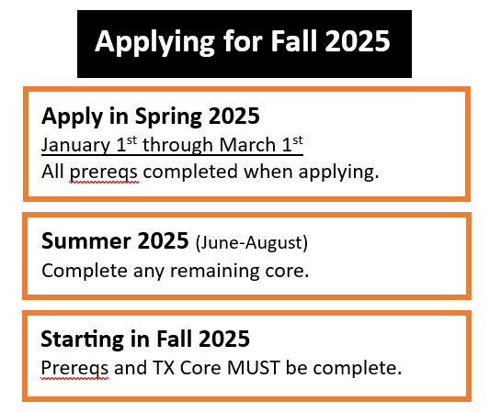
May 31

Slide 8
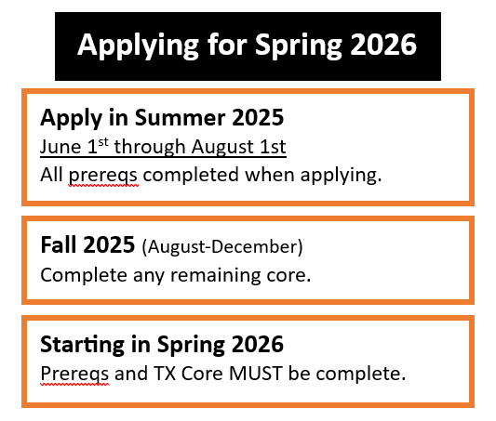

Slide 9
3 Educational Paths
Pre-Nursing to BSN – Students are classified as Pre-Nursing as they are taking prerequisite and lower-level courses
Approximately 85 applicants are accepted Fall & Spring to the BSN program out of 350+ applications
Licensed Vocational Nurse to BSN (LVN-BSN) – Applicants must have an LVN license to apply to this program
Up to 10 applicants are accepted each Fall & Spring
Same application dates as BSN
Online Registered Nurse to BSN (RN-BSN) – Applicants must have an RN license or be enrolled in an ADN* program to begin
*Alvin Community College, Blinn College, Lone Star College, Temple College
Notes:
We offer 3 Educational paths for nursing at SHSU. We classify students who are taking lower level degree requirements and prerequisites for the nursing program as Pre-Nursing students. The pre-licensure BSN program is our most competitive program. We have two application periods a year for this program and will accept around 90 students out of 350+ applicants.
We also have an LVN-BSN program designed for students who already have an LVN license. This application is open twice a year as well. We accept up to 10 LVN-BSN students each application cycle.
The other program we have is the RN-BSN program. This is designed for students who have an unencumbered TX or compact RN license or who are enrolled in an Associate Degree in Nursing program at one of our partner institutions.
This is the only program that offers summer courses the other two are face to face and in the Woodlands campus

Slide 10
BSN Application Requirements
Minimum GPA = 3.0 in Nursing Prerequisite and Overall (courses applicable to nursing)
“C” or higher in all attempted, applicable coursework by application deadline
No more than 2 graded attempts for a lab-science course within the past 7 years
Required lab-science courses completed within 7 years of beginning the nursing program (LVN-BSN and RN-BSN exempt)
Science courses must be 4 credit hrs. (lec/lab)
TEAS Exam (all sections required)
BLS- Healthcare Provider Certification through AHA (American Heart Association)
Immunization Records
Notes:
Other admission requirements are listed on this page
Students have to complete 6 out of the 8 prerequisite courses by the application deadline with no more than 2 in progress after the application period.
Important to note: If/when accepted and you do this ensure you send an official transcript to SHSU with the final grades for those two pending classes and the unofficial transcript to the nursing@shsu.edu email by the start of the program to ensure those courses were completed before program start date
The minimum gpas to be eligible to apply are a 3.0 in the 8 prerequisites and a 3.0 overall (with all courses that apply to nursing the TX core classes).
If you have business or LVN courses on your transcript, we will not look at those since they do not apply to the nursing degree requirements.
Also, if a course was ever retaken, we will use only the higher grade when calculating gpa for nursing admission
The minimum TEAS scores are a 70 overall and at least a 55 in each sub-section. We use Math and Reading for application ranking, but if you don’t meet the minimum requirements, your test will be invalid.
. Some majors at SHSU accept grades of D as credit for courses, however, the School of Nursing requires a C or higher in all lower-level courses since this is an expectation when/if accepted into the program. Students accepted into the nursing program have to earn a C or higher exam average and overall average to progress with the program.
The required lab-science courses have to be completed within 7 years of beginning the program (LVN-BSN and RN-BSN students are exempt from the expiration rule)
Again, we only allow 2 graded attempts in a lab-science course within the past 7 years. A third graded attempt will disqualify somebody from applying until the 1st attempt is expired. A W or Q or dropped is not considered a grade.
An active LVN license is required for LVN-BSN applicants and must be uploaded into the NursingCAS portal.

Slide 11
Clinical Requirements
Cleared background check
(exclusions do not guarantee clinical placement)
BLS Healthcare Provider certification card
Immunizations
Health insurance

Slide 12
Clinical Requirements What if I am not a US citizen?
Some clinical settings require proof of citizenship or official residency status from nursing students. If a student does not have required documentation to establish sufficient proof of citizenship or official residency status (e.g. driver’s license, passport, visa, employment authorization documentation, Texas identification card), it is very likely they will not be able to complete necessary clinical coursework. Students who do not complete clinical coursework will be unable to earn the BSN, resulting in the potential loss of significant time and money.
If you have questions, please contact our Global Engagement Center. Email: GEC@shsu.edu

Slide 13
Degree Requirements
Nursing Prerequisite Courses required by application deadline:
BIOL 2403 Anatomy and Physiology I
BIOL 2404 Anatomy and Physiology II
BIOL 2420 Medical Microbiology
CHEM 1406 Introductory Chemistry
MATH 1314 College Algebra
MATH 1342 Statistics
FACS 2362 Nutrition
PSYC 1301 General Psychology
PSYC 3374 Lifespan Growth and Development
Notes:
This slide shows the prerequisites and lower-level degree requirements for nursing. We used the Texas Common Course Numbers on this slide to assist students at local community colleges.
There are 8 prerequisites required to apply to our program and these are indicated in orange on the slide.
These are Anatomy and Physiology I, Anatomy and Physiology II, Chemistry, Microbiology, Statistics, Nutrition, General Psychology, and Lifespan Growth and Development or Developmental Psychology
Please keep in mind that Physiology I, Anatomy and Physiology II, Chemistry, Microbiology can only be repeated twice. If it is repeated three or more times you are automatically disqualified from admissions
The reason for this is to prepare you for success in our program. In the program if you get anything below a C twice, you are dismissed
The courses on the right, in blue, are the TX Core requirements. This is going to be your English courses, government, history, creative arts, etc. The courses listed show what is required for SHSU’s core curriculum, however, if you are core complete at one public institution in TX, you will be core complete at SHSU, and will not need to fulfill our core requirements if they differ from your previous school.

Slide 14
Degree Requirements
TX Core Curriculum required by start of the program :
Varies at every school
If you are core complete at one public institution in TX, you will be core complete at SHSU.
You must be core complete before you start the program

Slide 15
TEAS Exam
Test of Essential Academic Skills
Required for BSN and LVN-BSN applicants
Minimum overall score of 70 & 55 or higher for each section
atitesting.com
No limit on attempts; can only upload 1 Individual Performance Profile
TEAS 7 version must be taken within 2 years of application deadline
Notes:
We require the Test of Essential Academic Skills (TEAS) exam with our application for the pre-licensure and LVN-BSN programs at SHSU. This is a timed exam that will test you in 4 subject areas, reading, mathematics, science, and English and language usage. The mathematics section will have college algebra and statistics information, the science section will cover A&P I, A&P 2 and Chemistry information so this will test you on the content you are learning in your prerequisite courses for our program.
The link to register for the exam is on this slide and you will get a copy of this slide by the end of the day.
We do not have a limit as to how many times you take the TEAS but you can only upload one Individual Performance Profile to the application.
There is an example of what this Individual Performance Profile looks like on the application, make sure you see what it is so you know you are uploading the right document, many students do not and automatically do not get accepted because of this
We will accept the scores from TEAS version 7 AS LONG AS THEY WERE TAKEN WITHIN 2 YEARS OF THE APPLICATION DEADLINE

Slide 16
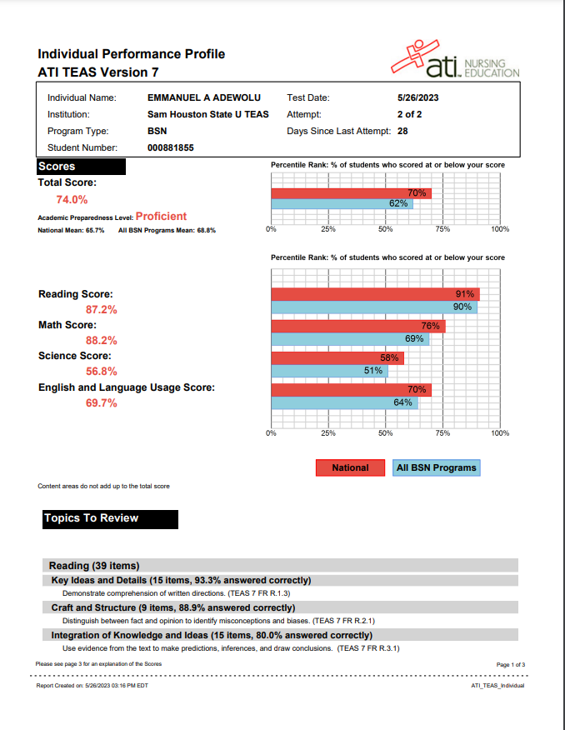
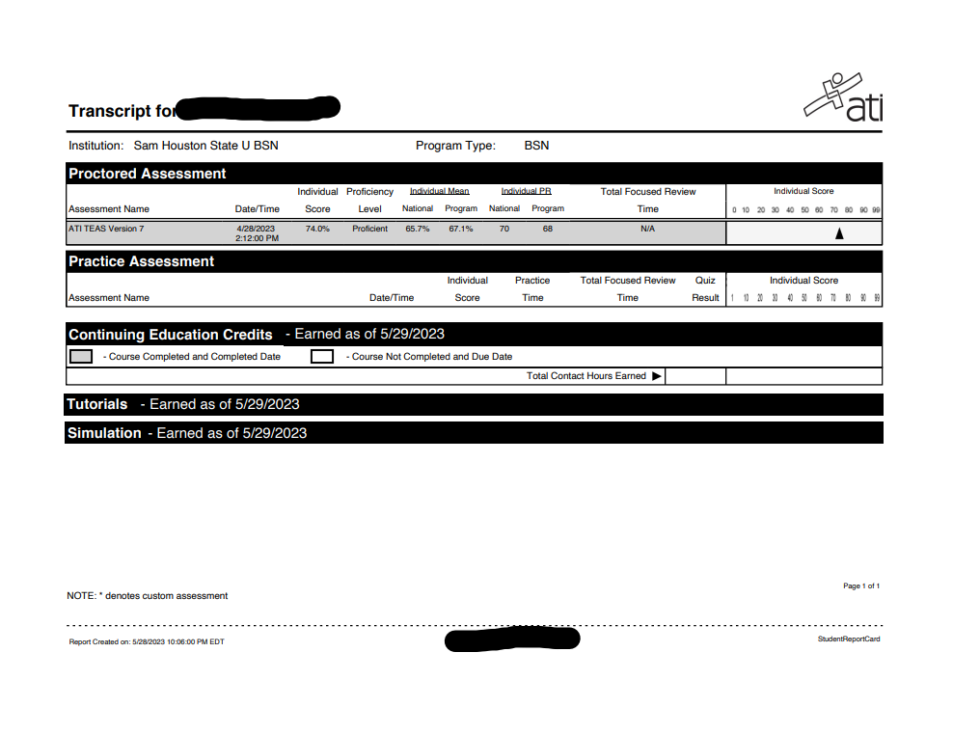
TEAS Upload- Most Common Error
WRONG
CORRECT
Notes:
Many had the wrong uploaded TEAS score. The first one is wrong due to the individual scores not being included. We look at the individual section scores as well as the overall score. The first PDF only shows your overall score.

Slide 17
Competitive Requirements
Pre-licensure BSN:
Prerequisite GPA = 3.7
Overall GPA = 3.6
TEAS Math Score = 90+
TEAS Reading Score = 80+
TEAS Overall Score = 80+
Bonus Points
Taking MATH 1370 (Biomedical Statistics)
10+ hours at SHSU
Veteran status
Nurse's Aide, Medical Assistant, EMT or Paramedic License (6 months experience)
A previous Bachelors/Master's Degree
Notes:
Those were the minimum requirements and these are the competitive gpas and TEAS scores using past application cycles.
This can change with every application cycle depending on the applicant pool.
We typically see around a 3.7 for the prereq and overall gpa and around a 90 for the TEAS math section and an 80 for the TEAS Reading section
Again, this is an average so we see accepted students with higher and lower gpas and scores than this.
Students can receive bonus points for various things such as every 10 hours at SHSU, veterans, previous Bachelor’s/Master’s degree (1 point per degree), a CNA, CMA, EMT, Paramedic license/certification w/ 6 months experience will all grant somebody a bonus point.
We rank students using the prereq gpa (the gpa of the 8 prerequisite courses), the TEAS Math and TEAS Reading scores from a test that meets minimum scores, and the overall gpa (gpa of courses that apply to the nursing program).
After we look at those, we add in any bonus points based on the bonus opportunities I previously mentioned.
The prereq gpa and TEAS Math and Reading scores are weighted at 80% of what we look at so those are important to try to do well in.

Slide 18
Steps to Apply
Acceptance to Sam Houston State University (www.applytexas.org)
Apply for the semester you wish to begin taking courses
Submission of School of Nursing application (www.nursingcas.org)
Official transcripts from every accredited institution attended
1 TEAS Individual Performance Profile
BLS Certification Card (American Heart Association)
Immunization records
All application items must be received at NursingCAS by application deadline
Notes:
We have a two step application process to apply to the School of Nursing.
The first step is to apply to SHSU through www.applytexas.org for the semester you wish to begin taking courses at SHSU
Students cannot apply as a Nursing major since you have to be accepted to join the School of Nursing
Apply for the semester you wish to start, as a transfer public health major-pre-nursing concentration.
After you are accepted to SHSU, you can apply to our nursing program through www.nursingcas.org when the application opens.
Please make sure to read the directions in the nursingcas portal as we don’t want you to be disqualified from not following the instructions.
You will fill out the application, enter in all college coursework, send official transcripts from all accredited institutions attended to nursingcas for review and upload 1 TEAS Individual Performance Profile
Many times students ask if they have to send official transcripts to NursingCAS even if they already sent them to Sam or they are a Sam student
Yes, yes you do, the application itself has to verify you have meet minimum requirement and if you do not send those transcripts by the application deadline you will not be verified and you will be automatically denied
We will have an application information session starting next month so we will go into more detail about the specifics of the nursingcas application and answer any questions you may have.

Slide 19
Health Insurance & Immunization Records
Health Insurance must be a comprehensive plan that covers a broad range of services
"Gold cards" or plans that restrict coverage to one facility or health condition (ex. women's health plan) are not acceptable
Not required for admission, but will be required for clinicals, SHSU Student Health Plan is acceptable
Immunizations
Upload immunization records to Nursing CAS:
MMR (2 doses or quantitative titer)
Varicella (2 doses or quantitative titer)
Hepatitis B Series
Hepatitis B titer
Tdap (given after age 18)

Slide 20
Admission Process
After the application deadline, all applications are carefully reviewed (this takes time)
Admission decisions are sent to your SHSU email address
In order to receive an admission decision, you must be accepted to SHSU and have a valid SHSU email address
Waitlisted students will be emailed (at SHSU email address) as spaces become available
Once admission decisions are made, all email communication is through your SHSU email address

Slide 21
RN-BSN

Slide 22
Reduction in Cost in RN-BSN
RN-BSN is approximately ($9,500) in tuition and fees
(30 hours of NURS courses)
30% Reduction in tuition and fees starting January 2025
Making our program more competitive with other online RN-BSN programs

Slide 23
RN-BSN Application Requirements
Similar prerequisite requirements as pre-licensure BSN
Substitutions can be made with a similar class for:
CHEM 1406 – Introductory Chemistry (another 4 hour science)
MATH 1314 – College Algebra (another MATH core course)
FACS 2362– Nutrition
Cumulative GPA of 2.5 and Prerequisite GPA of 2.5
“C” or better in all lower-level courses applicable to nursing
Unencumbered TX RN License (or Compact License) or currently enrolled in ADN program

Slide 24
Nursing Curriculum (RN-BSN)
1st Semester | 2nd Semester | 3rd Semester
NURS 3360 | NURS 4030 | NURS 3340
NURS 3370 | NURS 4383 | NURS 4381
NURS 4382 | NURS 4060 | NURS 4372
NURS 4384
12 hours | 9 hours | 9 hours
Italicized courses (non-clinical) can be taken as a jointly admitted student if student is in ADN program at one of the 4 partner community colleges
Notes:
This is the curriculum for the RN to BSN program
The italicized courses are non-clinical and can be taken as a joint admitted courses, the clinical courses cannot be taken until the completion of the ADN program.
Most students ask I took clinicals in my ADN program do I have to take them again?
These clinical courses are not like the ones you took during your ADN program, they are project based and most of our students complete them through their jobs.

Slide 25
Cost and Financial Aid Opportunities
Cost of the Nursing Program
BSN is approximately $34,700 in tuition and fees
(last 62 hours of program-NURS courses; does not include Pre-Nursing, lower-level requirements/prerequisites)
RN-BSN is approximately ($9,500) in tuition and fees
(30 hours of NURS courses)
30% Reduction in tuition and fees starting January 2025
FAFSA (www.fafsa.gov)
Grants
Loans
Scholarships4Kats
Complete 1 general application
Select and apply for scholarships you are eligible for
Up to 15 nursing specific scholarships
Employee tuition reimbursement
SHSU Cost Calculator https://www.shsu.edu/dept/cashiers/cost/cost-calculator
Notes:
The cost of the last 62 hours of the BSN and LVN-BSN programs is approximately $30,000 with tuition and fees.
The RN-BSN program is approximately $13,500 since there are only 30 hours of NURS courses
These numbers to do not include the cost of the lower level courses required for these program.
We encourage students to apply for FAFSA for possible grants and/or loans as well as Scholarships4Kats
Scholarships4Kats is located in your mySam account, and you complete 1 application and select the different scholarships you want to apply for. It is really neat because you don’t have to complete a new application for each scholarship, you only do one and select the ones to apply for. We have about 10-15 nursing student specific scholarship that we highly encourage students to apply for.
Many employers, especially those who are already RN, offer employee tuition reimbursement so make sure to ask your employer.

Slide 26
Contact Information
SHSU- The Woodlands Center (by appt only)
School of Nursing Advising Team
936-202-5109
prenursing@shsu.edu
School of Nursing Credentialing Specialist
SONclinicalorientation@shsu.edu
SHSU- SAM Center in Huntsville (by appt only)
College of Health Science / Prenursing Advisors
936-294-4444
samcenter@shsu.edu
Notes:
This is our contact information. If you want to send us your unofficial transcripts for review, please send them to prenursing@shsu.edu and we will further advise you.
We thank you for joining us today to hear about our nursing program at SHSU. Please continue to ask questions in the chat and we will try to respond to as many as possible. We will try to answer them for the next few minutes
Then we will begin the application Info session that goes over the NursingCAS app.

Slide 27
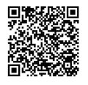
Stay Connected!
Follow Us on Social Media!
IG: @shsu_son
fb: SHSU School of Nursing
SHSU SON Website
Nursing Information Sessions

